Slide 1
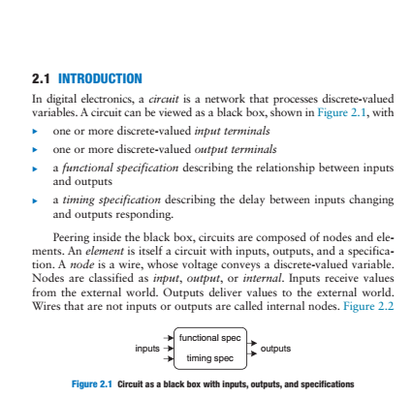
Combinational Circuit

Slide 2
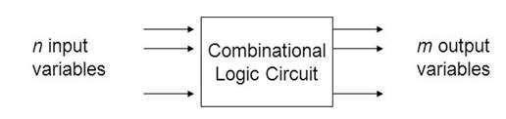
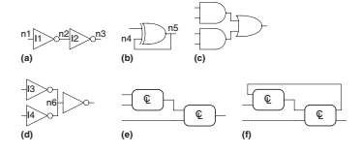
COMBINATIONAL CIRCUITS
Block diagram:
possible combinations of input values.
Specific functions of combinational circuits Adders, subtractors, multiplexers, comparators, Encoder, Decoder, ALU etc.

Slide 3
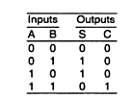

BINARY ADDERS
ADDERS
Half Adder
A Half Adder is a combinational circuit with two binary inputs (augends and addend bits and two binary outputs (sum and carry bits.) It adds the two inputs (A and B) and produces the sum (S) and the carry (C) bits.
Block diagram
Truth table
S um = A′B + A B′ = A B
Carry=AB

Slide 4
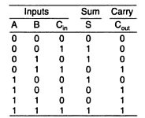



BINARY ADDERS
Full Adder
The full-adder adds the bits A and B and the carry from the previous column called the carry-in C_{in} and outputs the sum bit S and the carry bit called the carry-out C_{out} .
Block diagram
Truth table

Slide 5
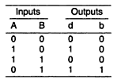

BINARY SUBTRACTORS
Half Subtractor
A Half-subtractor is a combinational circuit with two inputs A and B
and two outputs difference(d) and barrow(b).
Block diagram
Truth table
d= A′B + A B′= A B
b=A′B

Slide 6
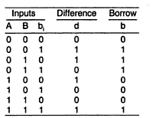

BINARY SUBTRACTORS
Full subtractor
The full subtractor perform subtraction of three input bits: the minuend, subtrahend, and borrow in and generates two output bits difference and borrow out.
Block diagram
Truth table

Slide 7
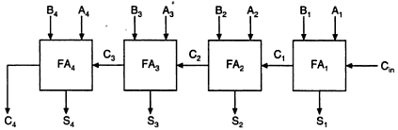
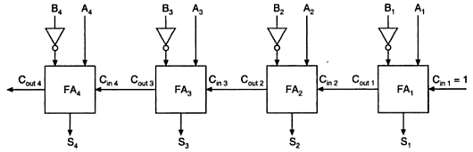
PARALLEL ADDER AND SUBTRACTOR
A binary parallel adder is a digital circuit that adds two binary numbers in parallel form and produces the arithmetic sum of those numbers in parallel form
parallel adder
parallel subtractor

Slide 8

CARRY LOOK-A- HEAD ADDER
In parallel-adder, the speed with which an addition can be performed is governed by the time required for the carries to propagate or ripple through all of the stages of the adder.
The look-ahead carry adder speeds up the process by eliminating
this ripple carry delay.

Slide 9
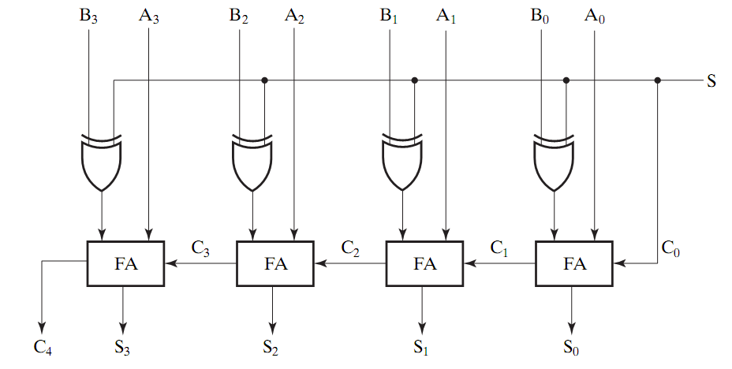
4 bit Adder/Subtractor
Using full adders and XOR we can build an Adder/Subtractor!
0 : Add
1: subtract

Slide 10
BINARY MULTIPLIER
A binary multiplier is an electronic circuit used in digital electronics, such as a computer, to multiply two binary numbers. It is built using binary adders.
Example: (101 x 011)
Partial products are: 101 × 1, 101 × 1, and 101 × 0
1 |  |  |  | 0 | 1
× 0 |  |  |  | 1 | 1
 |  |  | 1 | 0 | 1
 |  | 1 | 0 | 1
 | 0 | 0 | 0
0 | 0 | 1 | 1 | 1 | 1

Slide 11
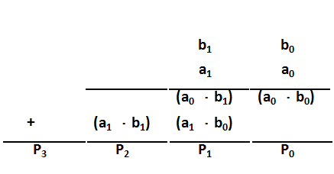
BINARY MULTIPLIER
We can also make an n × m “block” multiplier and use that to
form partial products.
Example: 2 × 2 – The logic equations for each partial-product
binary digit are shown below
We need to "add" the columns to get the product bits P0, P1,
P2, and P3.

Slide 12
BINARY MULTIPLIER
A0
B1
B0
A1
B1
B0
HA
HA
P₃ P₂ P₁ P₀
2 x 2 multiplier array

Slide 13
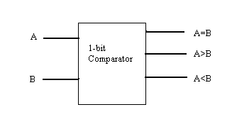
MAGNITUDE COMPARATOR
Magnitude comparator takes two numbers as input in binary form and determines whether one number is greater than, less than or equal to the other number.
1-Bit Magnitude Comparator
A comparator used to compare two bits is called a single bit comparator.
Block diagram

Slide 14
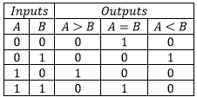
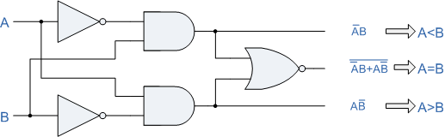
MAGNITUDE COMPARATOR
Logic diagram of 1-bit comparator

Slide 15
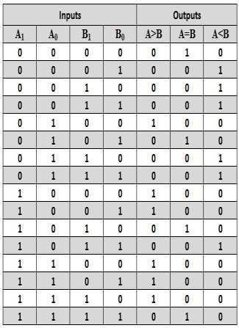
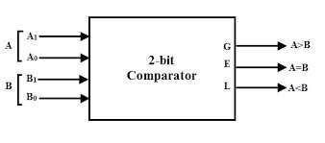
MAGNITUDE COMPARATOR
2 Bit magnitude comparator
Block diagram
Truth table

Slide 16
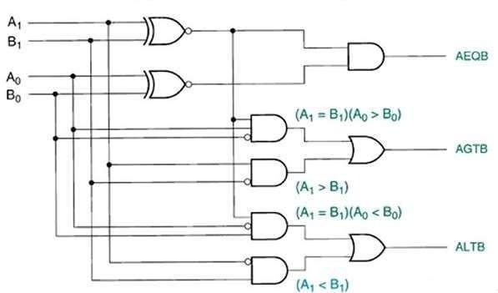
MAGNITUDE COMPARATOR
Logic diagram of 2-bit comparator

Slide 17
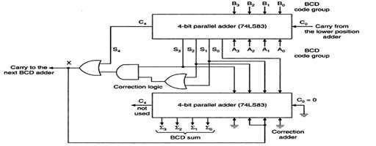
BCD ADDER
BCD Adder
Perform the addition of two decimal digits in BCD, together with an
input carry from a previousstage.
When the sum is 9 or less, the sum is in proper BCD form and no correction is needed.
When the sum of two digits is greater than 9, a correction of 0110 should be added to that sum, to produce the proper BCD result. This will produce a carry to be added to the next decimal position.

Slide 18
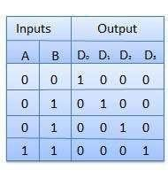
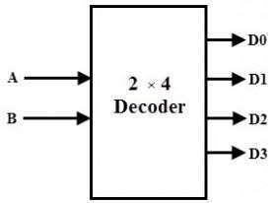
DECODER
A binary decoder is a combinational logic circuit that converts binary information from the n coded inputs to a maximum of 2^{n}unique outputs.
We have following types of decoders 2x4,3x8,4x16….
2x4 decoder
Truth table
Block diagram

Slide 19
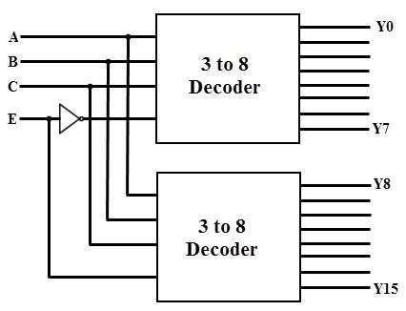
DECODERS
Higher order decoder implementation using lower order.
Ex:4x16 decoder using 3x8 decoders

Slide 20
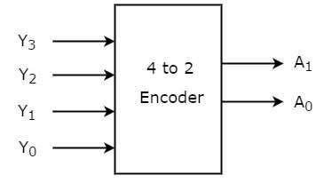
ENCODERS
An Encoder is a combinational circuit that performs the reverse operation of Decoder. It has maximum of 2^{n} input lines and ‘n’ output lines.
It will produce a binary code equivalent to the input, which is active
High.
Block diagram of 4x2 encoder

Slide 21
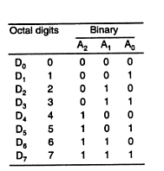
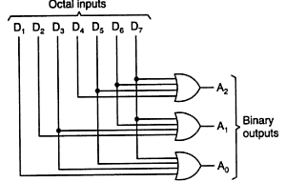
ENCODERS
Octal to binary encoder
Truth table
Logic diagram

Slide 22
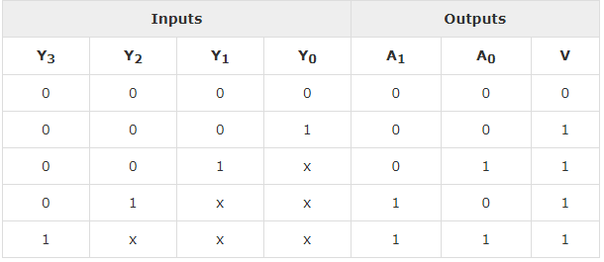
ENCODER
Priority encoder
A 4 to 2 priority encoder has four inputs Y₃, Y₂, Y₁ & Y₀ and two outputs A₁ & A₀. Here, the input, Y₃ has the highest priority, whereas the input, Y₀ has the lowestpriority.
Truth table

Slide 23
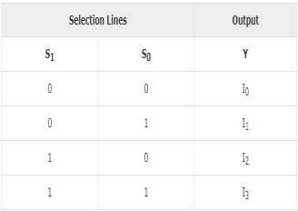
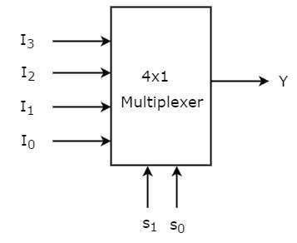
MULTIPLEXERS
Multiplexer is a combinational circuit that has maximum of 2^{n} data inputs, ‘n’ selection lines and single output line. One of these data inputs will be connected to the output based on the values of selection lines.
We have different types of multiplexers 2x1,4x1,8x1,16x1,32x1……
Fig 1: Block diagram
Fig 2: Truth table

Slide 24
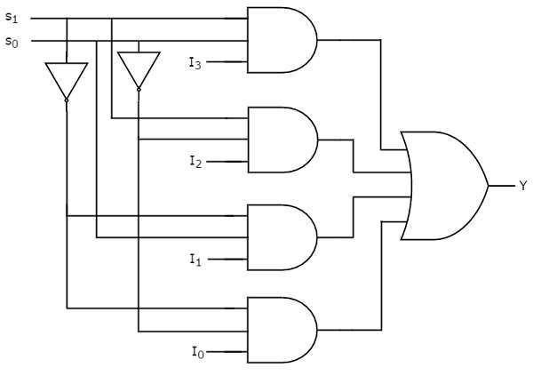
MULTIPLEXERS
Fig 3: Logic diagram
Now, let us implement the higher-order Multiplexer using lower-order Multiplexers.

Slide 25
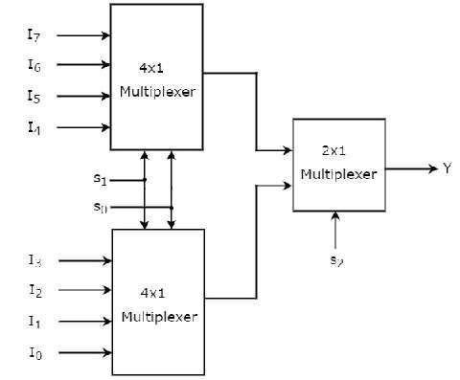
MULTIPLEXERS
Ex: 8x1 Multiplexer
Fig 3: 8x1 Multiplexerdiagram

Slide 26
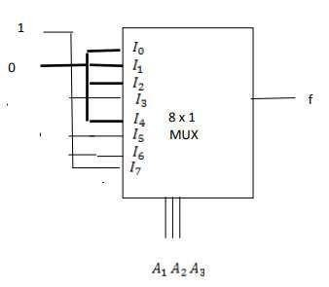
MULTIPLEXERS
Implementation of Boolean function using multiplexer
f(A1 , A2 , A3 ) =Σ(3,5,6,7) implementation using 8x1 mux

Slide 27
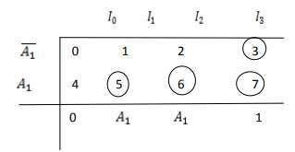
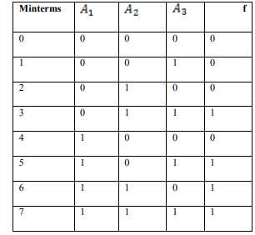
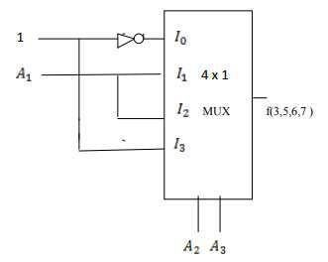
MULTIPLEXERS
f(A1 , A2 , A3 ) =Σ(3,5,6,7) implementation using 4x1 mux
Method:1
Fig 1: Truth table

Slide 28
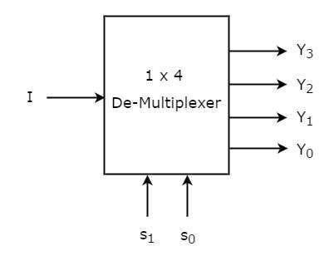
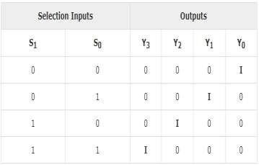
DEMULTIPLEXER
A demultiplexer is a device that takes a single input line and routes it to one of several digital output lines.
A demultiplexer of 2^{n} outputs has n select lines, which are used to select which output line to send the input.
We have 1x2, 1x4, 8x1…. Demultiplexers.
Block diagram
Truth table

Slide 29
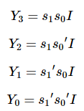
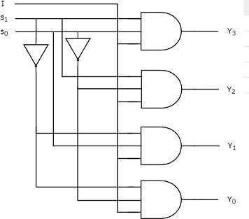
DEMULTIPLEXER
Boolean functions for each output as
Logic diagram

Slide 30
What is meant by code?
The digital data is represented, stored and transmitted as group of binary bits. This group is also called as binary code. The binary code is represented by the number as well as alphanumeric letter.
Codes are classified in to 2 types
Weighted
Non-weighted

Slide 31
WEIGHTED CODE
In weighted code, each digit position has a weight or value.
The sum of all digits multiplied by a weight gives a total amount being represented.
BCD or 8421 is a type of weighted code where each digit position is assigned a specific weight.
NON WEIGHTED CODE
In non weighted code there is no positional weight
i.e., Each position within the binary number is not assigned a prefix value.
No specific positions are assigned to bit positions in non weighted code.
The non weighted codes are (1) Gray code (2) Excess-3 code.

Slide 32
Code converters
Code conversion is used to change the data present in one type of binary code to another type of binary code. Some of the codes are BCD, Gray, Excess 3, ASCII and so on.
Some of the conversions are
Binary to Gray code conversion
Gray to Binary code conversion
BCD to Excess-3 code conversion
Excess-3 to BCD code conversion

Slide 33
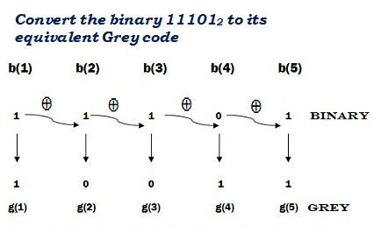
Binary to Gray code conversion
The Gray code is non-weighted code, as the position of bit does not contain any weight. The Gray code is a reflective digital code which has the special property that any two subsequent numbers codes differ by only one bit. This is also called a unit- distance code.
The generation of 4-bit Gray code can be calculated by using formula.
G₁ = Β₁
G₂ = Β₁⊕Β₂
G₃ = Β₂⊕Β₃
G₄ = Β₃⊕Β₄

Slide 34
A four-bit binary to Gray code conversion table is as shown below.
Four Bit Binary Number |  |  |  | Four Bit Gray Code
B₁ | B₂ | B₃ | B₄ | G₁ | G₂ | G₃ | G₄
0 | 0 | 0 | 0 | 0 | 0 | 0 | 0
0 | 0 | 0 | 1 | 0 | 0 | 0 | 1
0 | 0 | 1 | 0 | 0 | 0 | 1 | 1
0 | 0 | 1 | 1 | 0 | 0 | 1 | 0
0 | 1 | 0 | 0 | 0 | 1 | 1 | 0
0 | 1 | 0 | 1 | 0 | 1 | 1 | 1
0 | 1 | 1 | 0 | 0 | 1 | 0 | 1
0 | 1 | 1 | 1 | 0 | 1 | 0 | 0
1 | 0 | 0 | 0 | 1 | 1 | 0 | 0
1 | 0 | 0 | 1 | 1 | 1 | 0 | 1
1 | 0 | 1 | 0 | 1 | 1 | 1 | 1
1 | 0 | 1 | 1 | 1 | 1 | 1 | 0
1 | 1 | 0 | 0 | 1 | 0 | 1 | 0
1 | 1 | 0 | 1 | 1 | 0 | 1 | 1
1 | 1 | 1 | 0 | 1 | 0 | 0 | 1
1 | 1 | 1 | 1 | 1 | 0 | 0 | 0

Slide 35
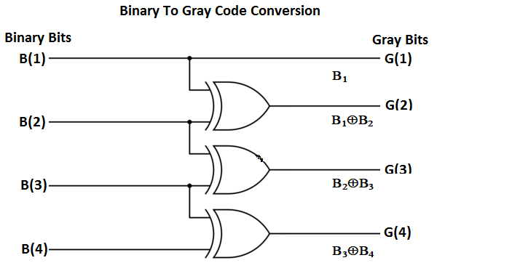
The circuit for Binary to Gray code conversion is

Slide 36
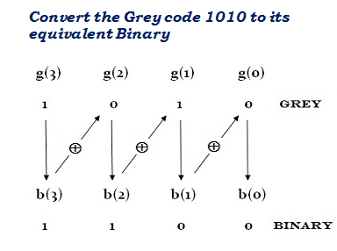
Gray to binary code conversion
In Gray to binary conversion, the input is Gray code and output is its equivalent binary code.
The generation of four-bit binary equivalent code can be calculated by using formula.
Β₁ = G₁
Β₂ = G₂ ⊕ Β₁
Β₃ = G₃ ⊕ Β₂
Β₄ = G₄ ⊕ Β₃
The MSB of binary code is similar to the MSB of Gray code.
To get next bit, use the ex-oring operation among the MSB of binary to the next bit of the Gray code.
Similarly, to get the third bit, it uses the ex-oring operation among the second bit to the third MSB of the Gray code and so on.

Slide 37
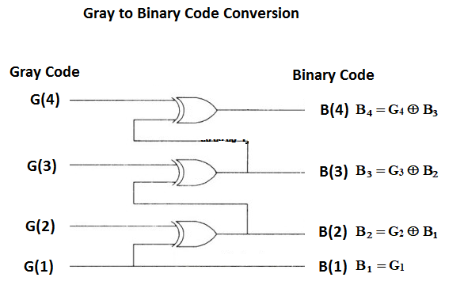
The Gray to binary conversion method can be done by using ex-oring logic gate.
A four-bit Gray to binary code converter is as shown below.

Slide 38
A four-bit Gray to binary code conversion table is as shown below.
Four Bit Gray Code |  |  |  | Four Bit Binary Number
G₁ | G₂ | G₃ | G₄ | B₁ | B₂ | B₃ | B₄
0 | 0 | 0 | 0 | 0 | 0 | 0 | 0
0 | 0 | 0 | 1 | 0 | 0 | 0 | 1
0 | 0 | 1 | 1 | 0 | 0 | 1 | 0
0 | 0 | 1 | 0 | 0 | 0 | 1 | 1
0 | 1 | 1 | 0 | 0 | 1 | 0 | 0
0 | 1 | 1 | 1 | 0 | 1 | 0 | 1
0 | 1 | 0 | 1 | 0 | 1 | 1 | 0
0 | 1 | 0 | 0 | 0 | 1 | 1 | 1
1 | 1 | 0 | 0 | 1 | 0 | 0 | 0
1 | 1 | 0 | 1 | 1 | 0 | 0 | 1
1 | 1 | 1 | 1 | 1 | 0 | 1 | 0
1 | 1 | 1 | 0 | 1 | 0 | 1 | 1
1 | 0 | 1 | 0 | 1 | 1 | 0 | 0
1 | 0 | 1 | 1 | 1 | 1 | 0 | 1
1 | 0 | 0 | 1 | 1 | 1 | 1 | 0
1 | 0 | 0 | 0 | 1 | 1 | 1 | 1

Slide 39
BCD to Excess 3 code
Excess-3 codes are unweighted and can be obtained by adding 3 to each decimal digit then it can be represented by using 4-bit binary number for each digit.
To find the decimal equivalent of the given binary number. Add 0011 to each four-bit group in binary coded decimal number (BCD) to get desired excess-3 equivalent.
The variables B₀, B₁, B₂, and B₃ represent the bits of the binary numbers.
The variable 'B₀' represents the LSB, and the variable 'B₃' represents the MSB.
The variables E₀, E₁, E₂, and E₃ represent the bits of the Excess-3 code.
The variable 'E₀' represents the LSB, and the variable 'E₃' represents the MSB.

Slide 40
The truth table for BCD to Excess-3 code converter can be determined as shown in table below.
For impossible four bit Excess-3 code we use output as Don’t care conditions. The 'don't care conditions' is defined by the variable 'X'.
 | BCD Number |  |  |  | Excess-3 Code Number
Decimal | B₃ | B₂ | B₁ | B₀ | E₃ | E₂ | E₁ | E₀
0 | 0 | 0 | 0 | 0 | 0 | 0 | 1 | 1
1 | 0 | 0 | 0 | 1 | 0 | 1 | 0 | 0
2 | 0 | 0 | 1 | 0 | 0 | 1 | 0 | 1
3 | 0 | 0 | 1 | 1 | 0 | 1 | 1 | 0
4 | 0 | 1 | 0 | 0 | 0 | 1 | 1 | 1
5 | 0 | 1 | 0 | 1 | 1 | 0 | 0 | 0
6 | 0 | 1 | 1 | 0 | 1 | 0 | 0 | 1
7 | 0 | 1 | 1 | 1 | 1 | 0 | 1 | 0
8 | 1 | 0 | 0 | 0 | 1 | 0 | 1 | 1
9 | 1 | 0 | 0 | 1 | 1 | 1 | 0 | 0

Slide 41
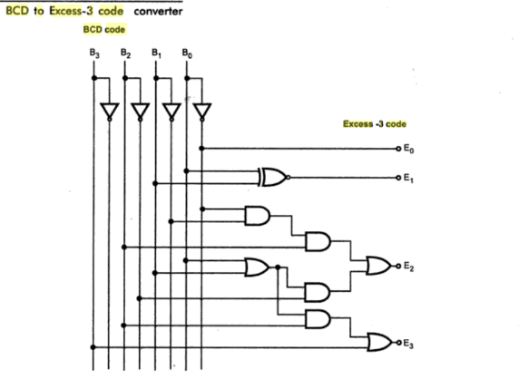
The circuit diagram for BCD to Excess-3 code converter is shown below

Slide 42
Excess-3 to BCD converter
The process of converting Excess-3 to BCD is opposite to the process of converting BCD to Excess-3.
The BCD code can be calculated by subtracting 3, i.e., 0011 from each four-digit Excess-3 code.
The variables E₀, E₁, E₂, and E₃ represent the bits of the Excess-3 code.
The variable 'E₀' represents the LSB, and the variable 'E₃' represents the MSB.
The variables B₀, B₁, B₂, and B₃ represent the bits of the binary numbers.
The variable 'B₀' represents the LSB, and the variable 'B₃' represents the MSB.
The 'don't care conditions' is defined by the variable 'X'.

Slide 43
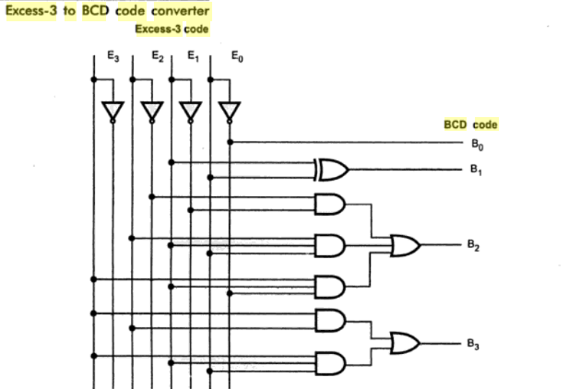
The circuit diagram for Excess-3 code to BCD converter is shown below

Slide 44
The truth table for BCD to Excess-3 code converter can be determined as shown in table below.
 | Excess-3 Code Number |  |  |  | BCD Number
Decimal | E₃ | E₂ | E₁ | E₀ | B₃ | B₂ | B₁ | B₀
0 | 0 | 0 | 1 | 1 | 0 | 0 | 0 | 0
1 | 0 | 1 | 0 | 0 | 0 | 0 | 0 | 1
2 | 0 | 1 | 0 | 1 | 0 | 0 | 1 | 0
3 | 0 | 1 | 1 | 0 | 0 | 0 | 1 | 1
4 | 0 | 1 | 1 | 1 | 0 | 1 | 0 | 0
5 | 1 | 0 | 0 | 0 | 0 | 1 | 0 | 1
6 | 1 | 0 | 0 | 1 | 0 | 1 | 1 | 0
7 | 1 | 0 | 1 | 0 | 0 | 1 | 1 | 1
8 | 1 | 0 | 1 | 1 | 1 | 0 | 0 | 0
9 | 1 | 1 | 0 | 0 | 1 | 0 | 0 | 1

